Slide 1









Neural Shape Mating: Self-Supervised Object Assembly with Adversarial Shape Priors
Yun-Chun Chen
Haoda Li
Dylan Turpin
Alec Jacobson
Animesh Garg

Slide 2
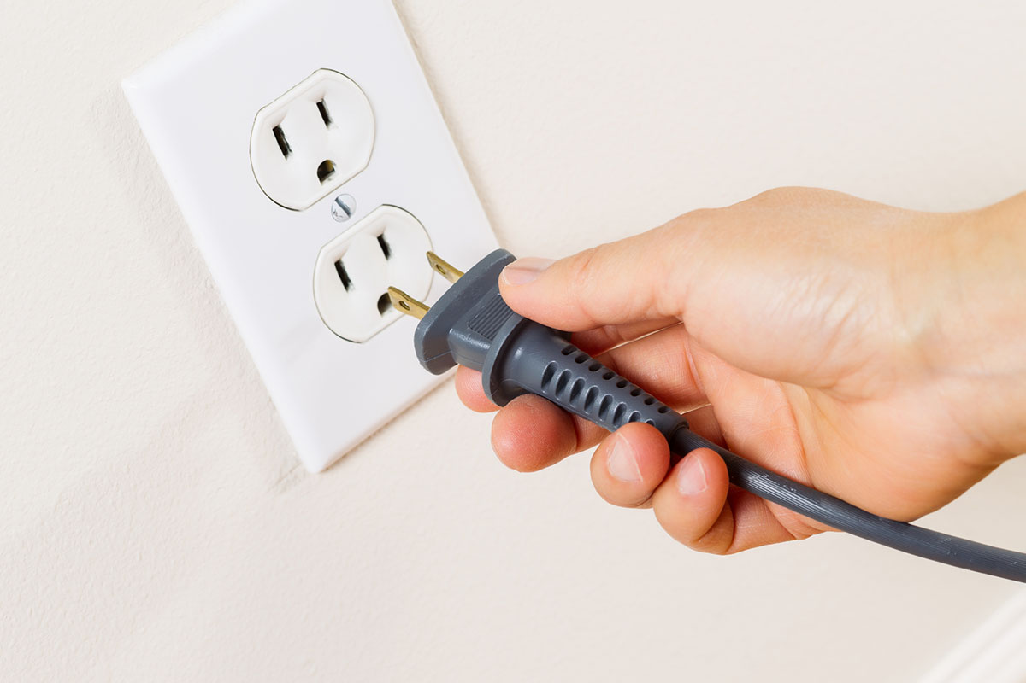
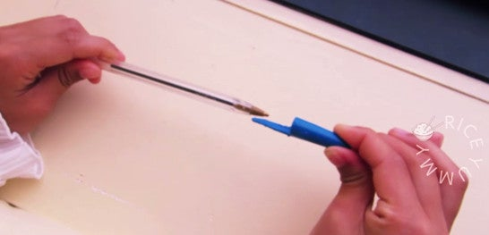
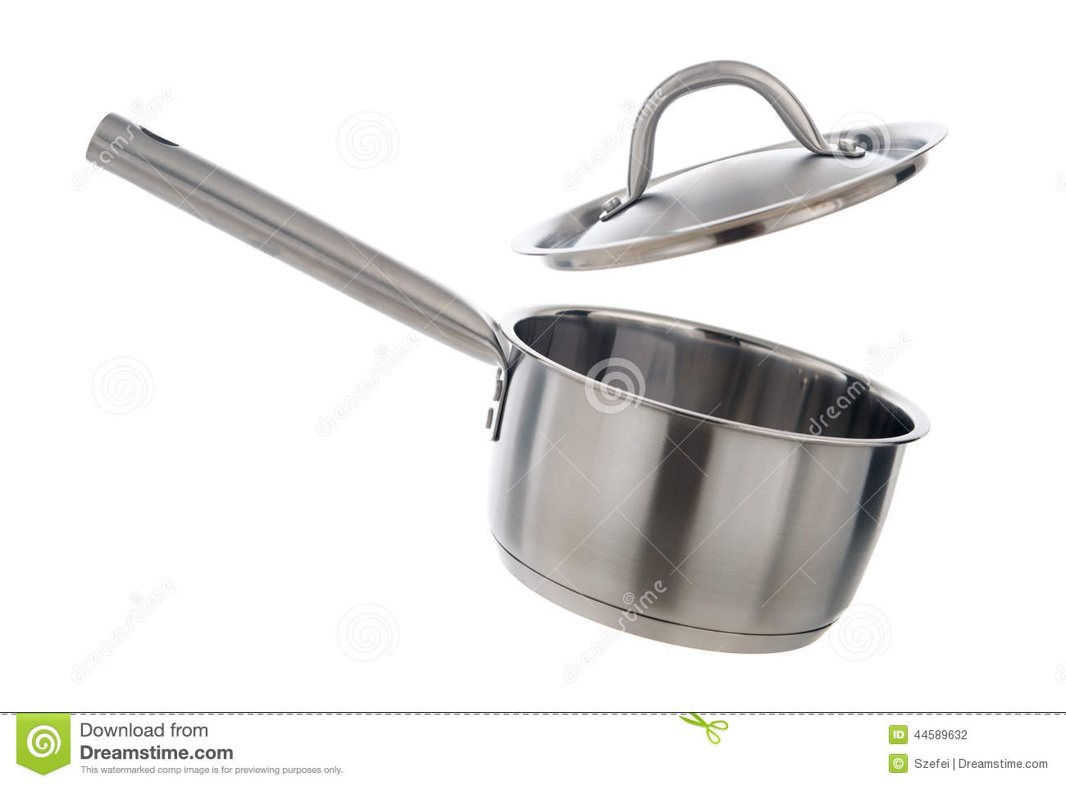
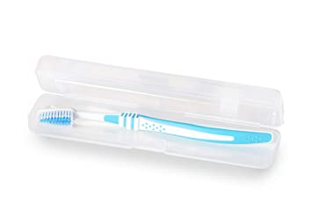
3D Shape Assembly
Plug and Socket
Pen and Cap
Pot and Lid
Toothbrush and Case

Slide 3
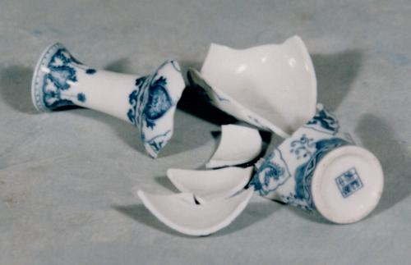
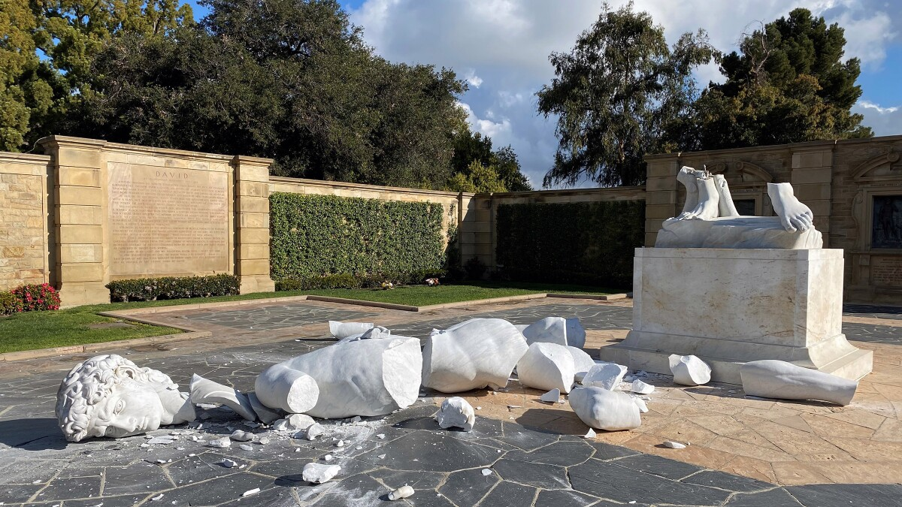
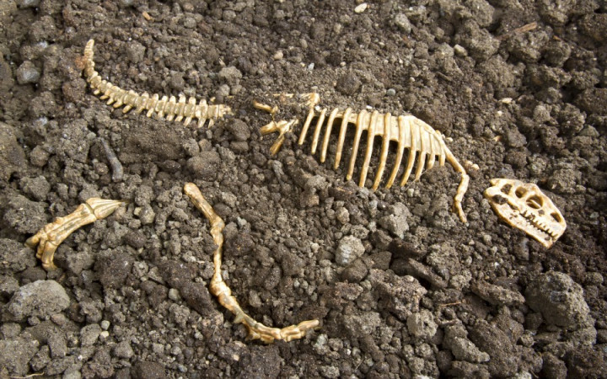
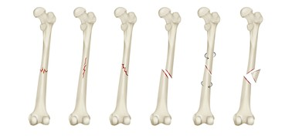
3D Geometric Shape Assembly
Broken vase
Broken sculpture
Broken fossil
Broken bones

Slide 4
Pairwise 3D Geometric Shape Assembly
Input: Two shapes
Goal: Develop an algorithm that learns to assemble them

Slide 5
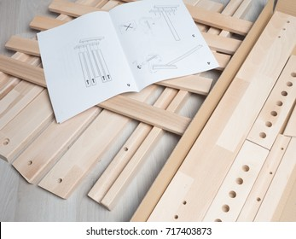
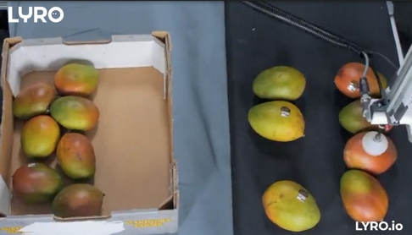
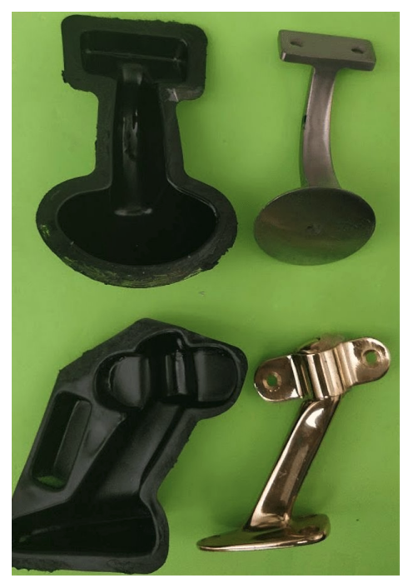
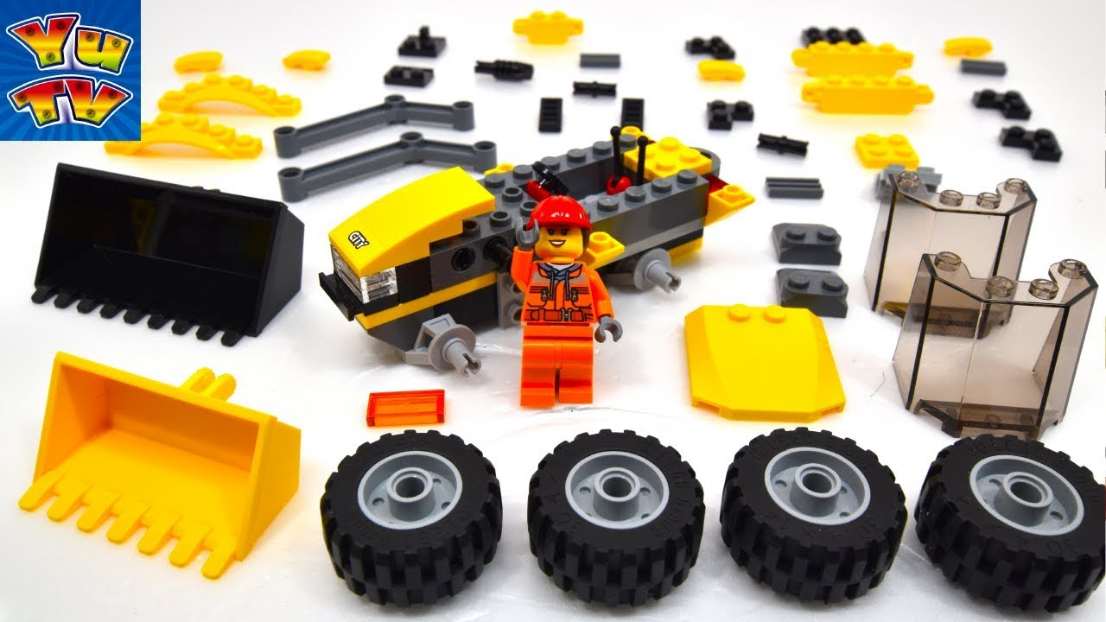
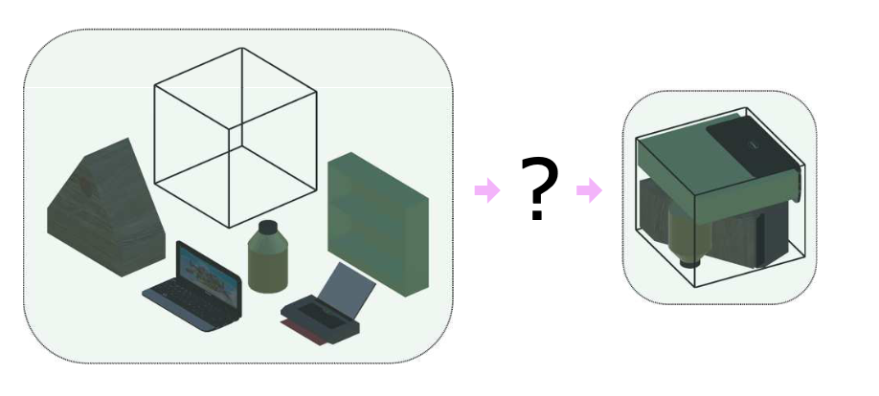
Applications
Furniture Assembly
Pick and Place
Toy Assembly
Object Packing
Object Kitting

Slide 6
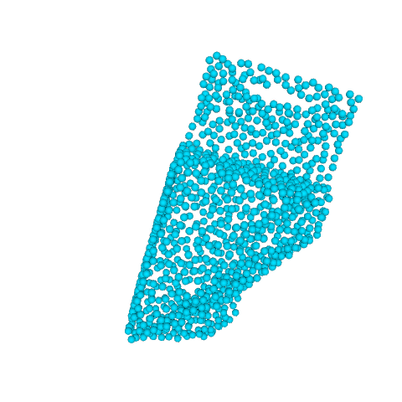
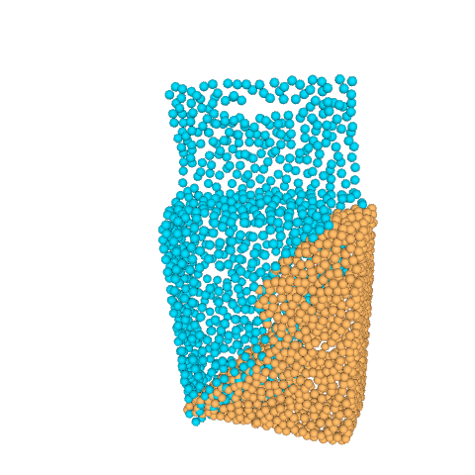
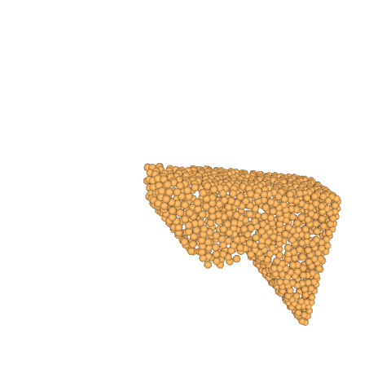
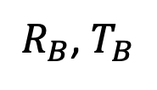
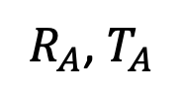
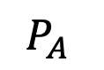
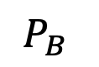
Task Formulation
Input: Two point clouds $P_{A}$ and $P_{B}$
Output: SE(3) poses for $P_{A}$ and $P_{B}$
$R_{A}$, $T_{A}$
$$P_{A}$$
Neural Shape Mating
$R_{B}$, $T_{B}$
$$P_{B}$$
Predicted Poses
Assembly Result

Slide 7
Feature Extraction

Slide 8
Cross-Shape Correlation
≈

Slide 9
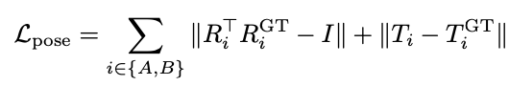
Pose Estimation for Shape Assembly
Pose estimation loss

Slide 10
Adversarial Learning of Shape Priors
Adversarial loss

Slide 11
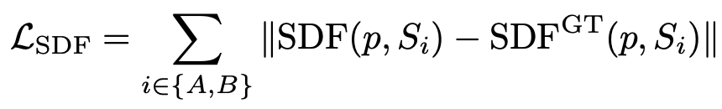
Shape Reconstruction
SDF regression loss

Slide 12
Dataset
Shell
Solid
Object Meshes
Different Cut Types
Random Poses

Slide 13
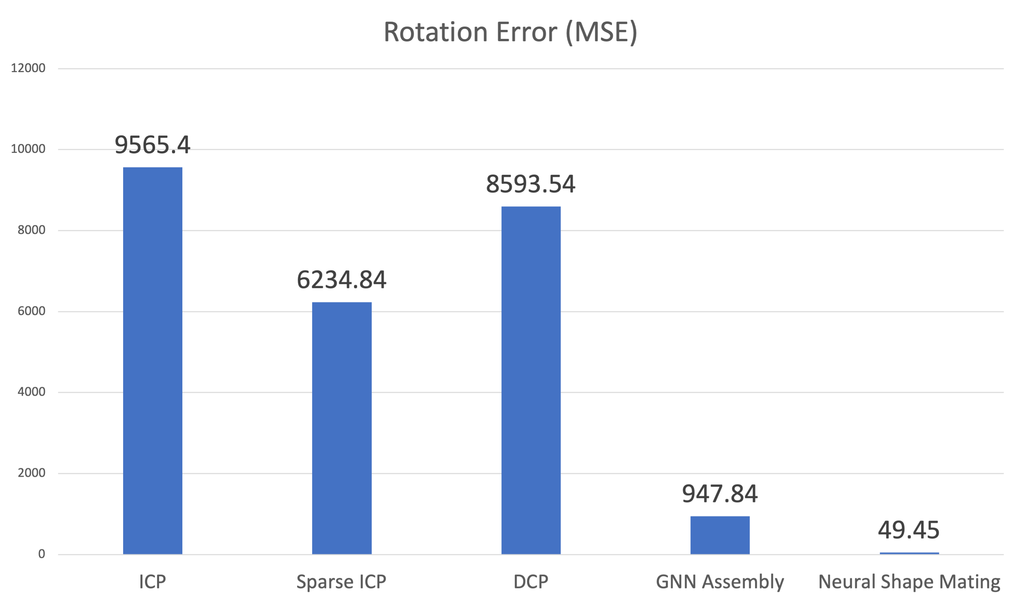
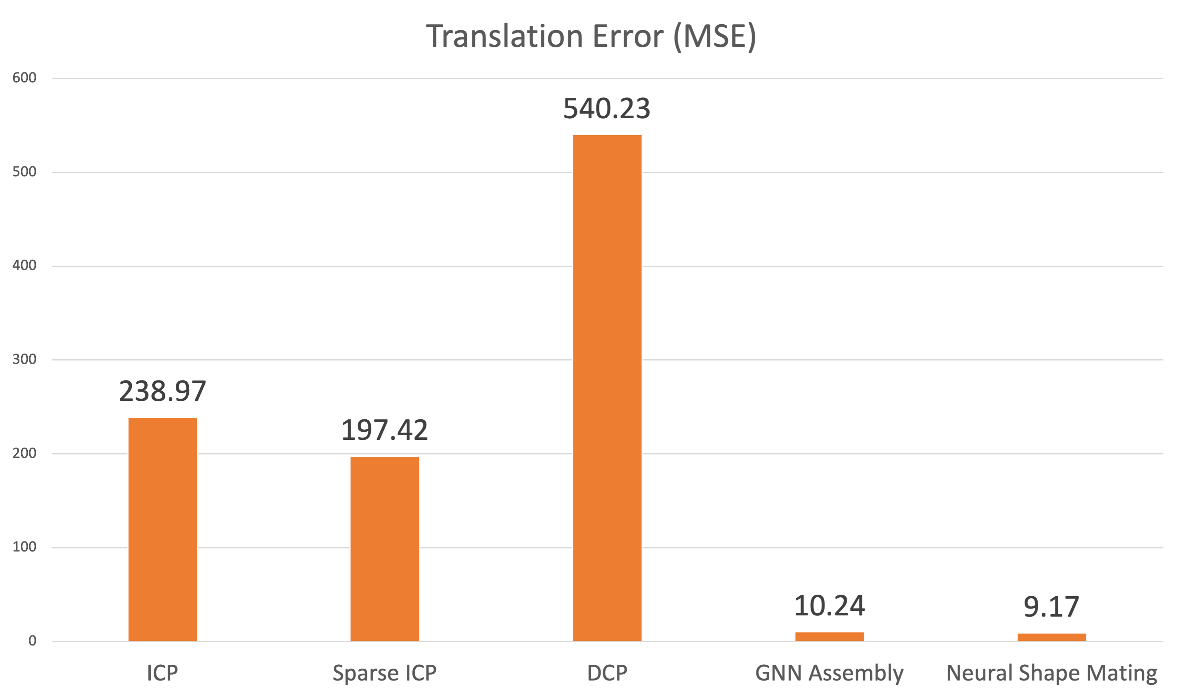
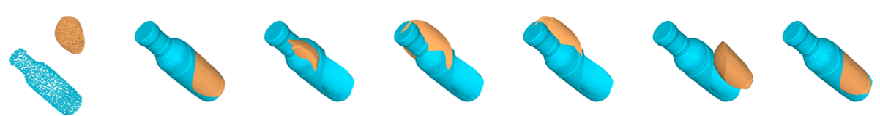
Experimental Results
Rotation Error (MSE)
Translation Error (MSE)
ICP
Sparse ICP
DCP
GNN Assembly
Ours
ICP
Sparse ICP
DCP
GNN Assembly
Ours
Input
Ground Truth
ICP
Sparse ICP
DCP
GNN Assembly
Ours

Slide 14
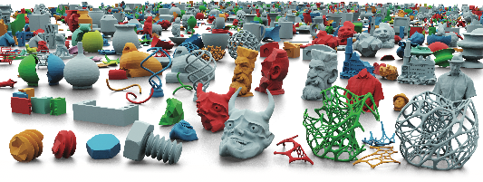
Future Work - Multi-part Assembly

